Slide 1
Predicting Student Success from Non-Academic Factors
COMP 4442 Final Project
Luke Sonnanburg

Slide 2
Research Question
Question
Motivation
Can we apply factor analysis to data on student habits and backgrounds to predict student test scores?
Identify healthy/productive behaviors to promote
Predict which students might need extra support
Determine external factors that may be remedied with investment

Slide 3
Student Performance Data Set
Provided by University of Minho, Portugal, via the UCI Machine Learning Repository
Captures data on two secondary education schools (grades 10-12)
Contains data on student trimester test scores in math and Portuguese classes
For this analysis, the predicted variable is the average of all three grades
Contains 30 other variables on student background and behavior

Slide 4
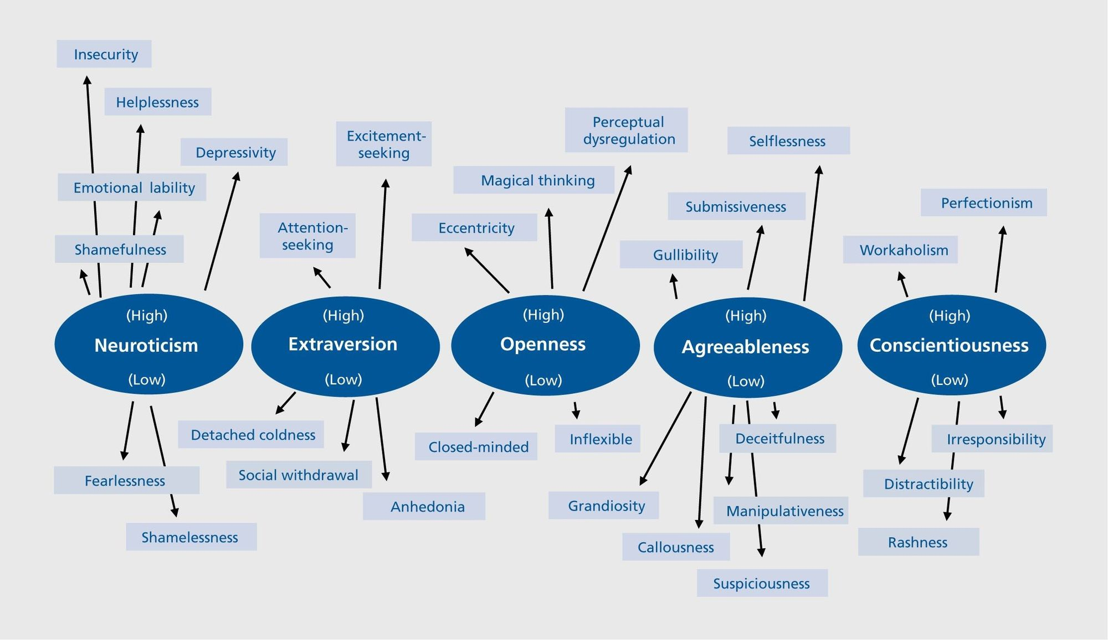
Factor Analysis: Overview
"Big Five" Personality Traits
Find variables with strong covariance
Determine good number of "factors"
Factors = unobserved variables reflected by groups of observed variables moving together
Make that many factors by combining weights of covariant observed variables
Select a "rotation" that controls how variables are loaded into those factors
Typical result of applying factor analysis to personality surveys

Slide 5
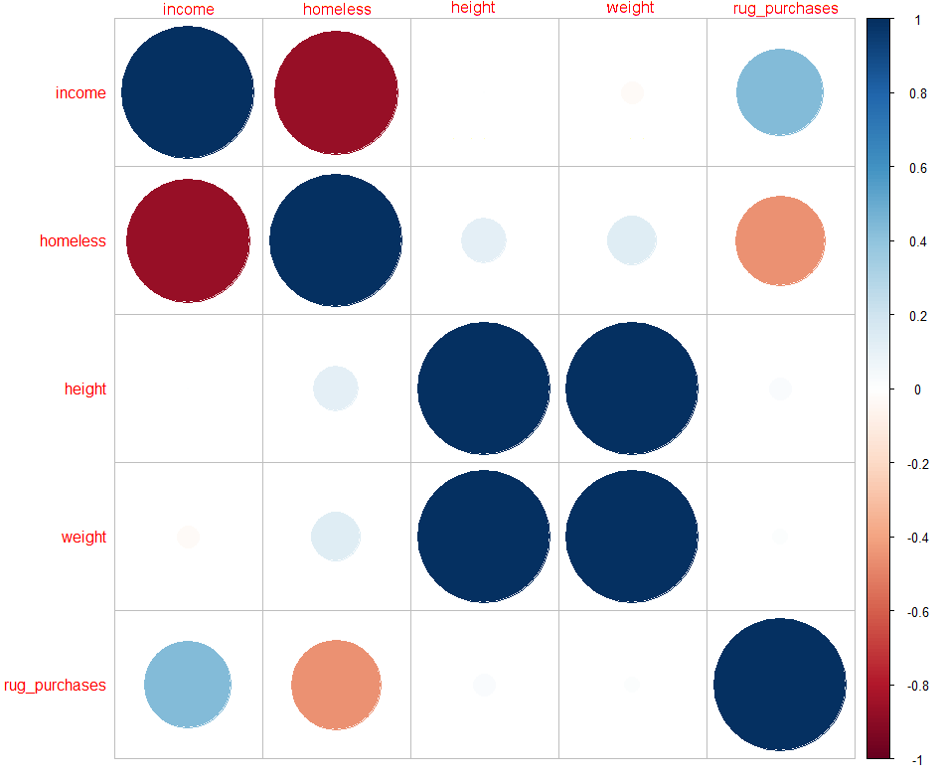
Sales Example: Correlation
Suppose we're in the business of selling rugs.
We have four variables describing potential customers:
Their income
Whether they're homeless
Height
Weight
Income and homelessness have strong negative correlation
Height and weight have strong positive correlation

Slide 6
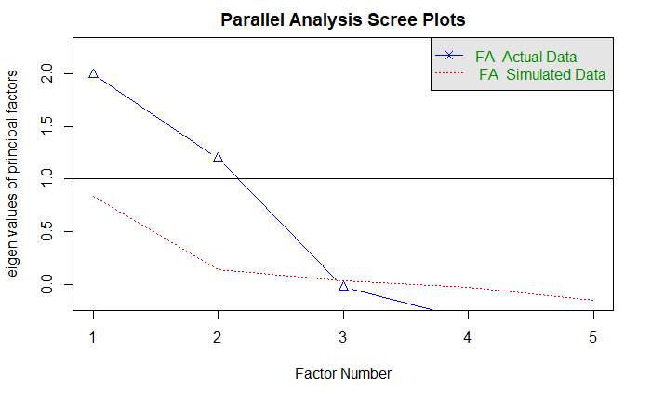
Sales Example: Scree Plot
Scree plot:
Charts eigenvalues of the data's correlation matrix.
Eigenvalues >=1 imply greater predictive power than an individual variable.
Here two eigenvectors are >=1;
We'll use two factors.

Slide 7
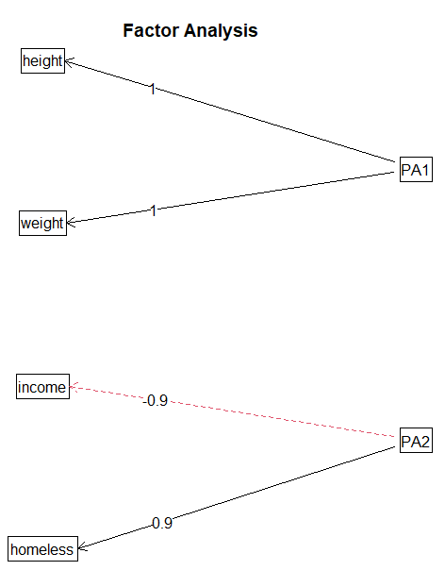
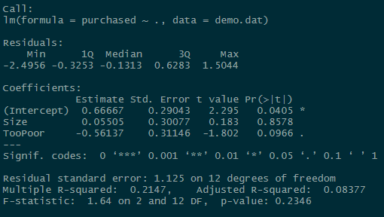
Sales Example: Results
We've decided on two factors and earlier found two sets of covariant variables.
From here we can name our new factors.
Factor | Variables
Customer Size | Height, Weight
Too poor to buy rugs | -Income, Homelessness

Slide 8
Factor "Rotation"
Rotating factors means reshuffling data to fit assumptions made about factors
Two commonly used types:
Varimax rotation
Assumes factors are orthogonal; do not correlate
Finds factors that explain maximum variance
Tends to find simpler/easily understood factor loadings
Oblimin rotation
Assumes factors can correlate
Includes orthogonal solutions but rarely selects them
Generally more realistic for complex systems/psychometry

Slide 9
Why Use Factor Analysis?
Our student dataset has values for...
School attended
Age and sex
Family size
Parents' marital status
Parents' education
Parents' jobs
Family support (emotional, financial)
Reason for attending this school
Interest in higher education
Extra tutoring
Travel time to school
Study habits
Drinking habits
Romantic involvement
...and more!
30 is too many variables to summarize simply and surely some group together.

Slide 10
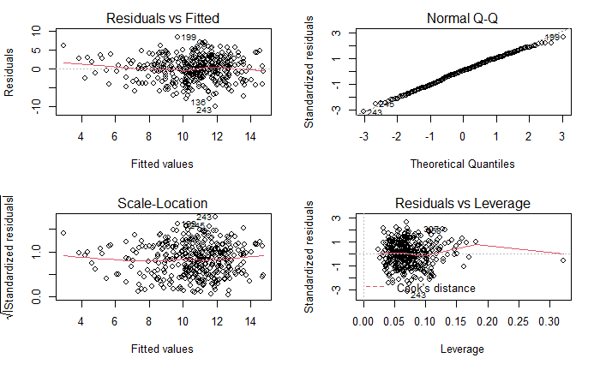
Data Manipulation & Diagnostics
Typical factor analysis requires linear data, benefits from normally distributed data.
Categorical data was either dropped or coded into binaries where appropriate.
There are no significant problems in the diagnostic plots.

Slide 11
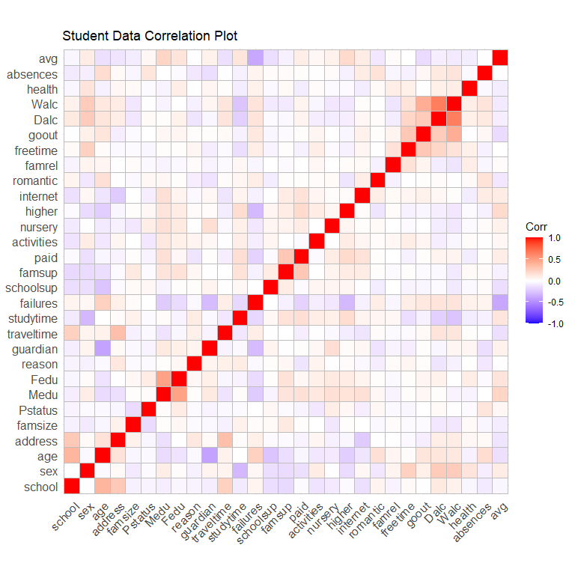
There aren't many obvious groupings of covariant variables.
Luckily, R takes care of making these connections for us.

Slide 12
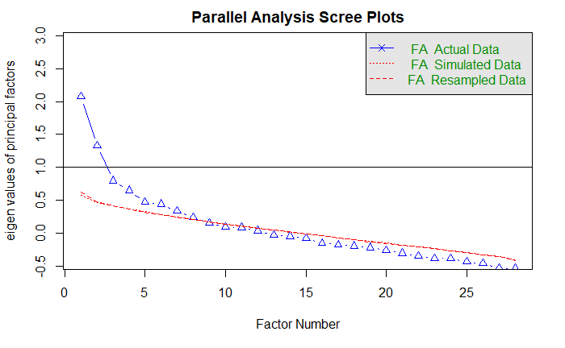
Student Data Scree Plot
Different approaches to Scree plots...
Stop at λ < 1: gives us two factors
Stop at first "leveling off": five factors
Best number of factors should lie in the interval [2,5]
Tests were run on 2,3,4,5 factors using oblimin and varimax rotations.

Slide 13
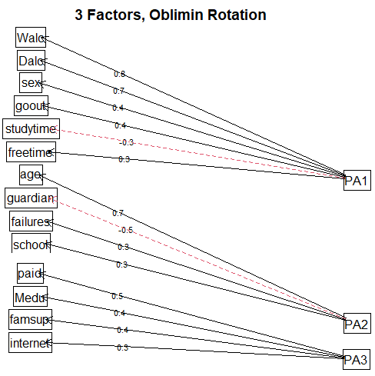
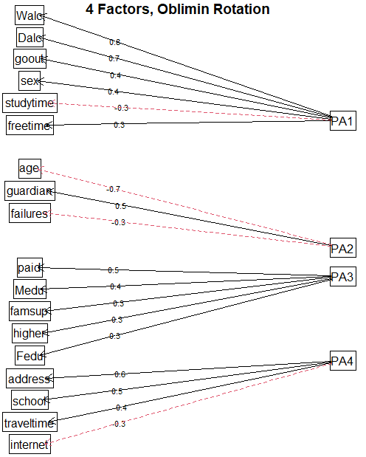
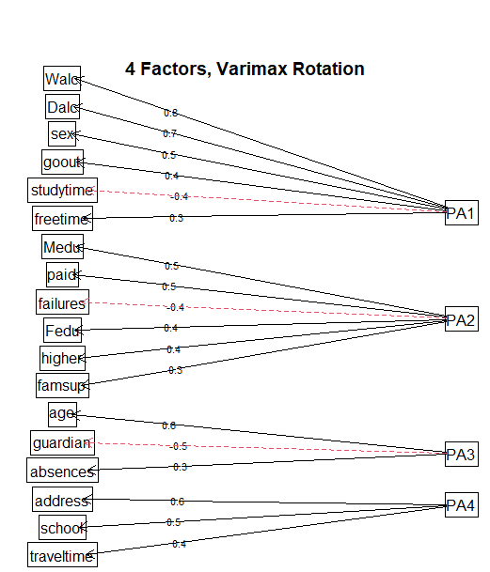
Examples of Candidate Factorizations

Slide 14
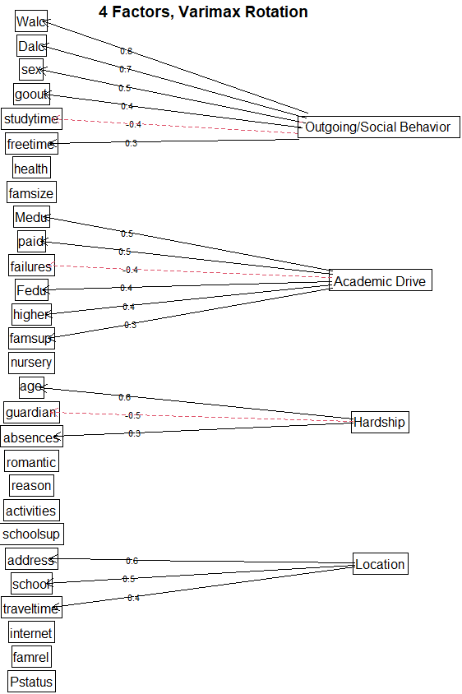
Selected Model
Models were compared and judged based on:
% of academic score variance explained by factors
How much the resulting factors "made sense"/could be easily understood
Residual errors/R-squared values of regression performed on factors

Slide 15
Selected Model
Factor | Loaded variables
Outgoingness/Social Behavior | Weekend and daily alcohol consumption, how often student goes out, how little they study, how much free time they have, biological sex(?)
Academic Drive/Background | Parents' Education, paid tutoring, a lack of previous failures, aspirations to higher education, family's financial support
Hardship | Student's age, student being raised with non-biological parents, student number of absences
Rural Location | Student living in a rural location, going to the more isolated of the two schools observed, taking longer to travel to school

Slide 16
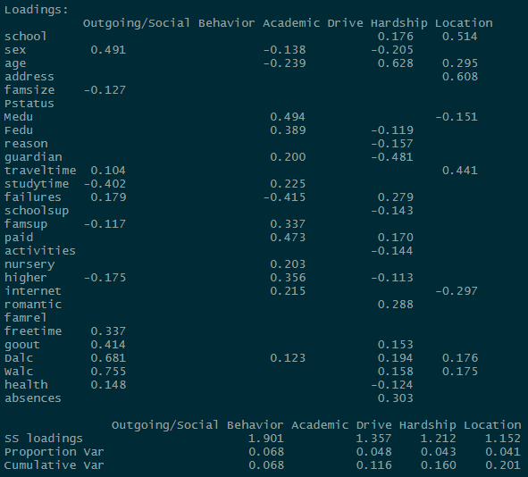
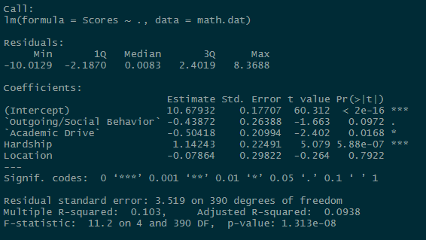
Selected Model... is not very good
.201% Cumulative
Variance Explained
R-squared 0.103
Adjusted R-squared 0.0938

Slide 17
What Went Wrong?
Needing to coerce the data into a linear form to perform factor analysis probably hurt the analysis more than expected
Most variables had weak correlation to begin with; only 2 factors have predictive power
Kaiser-Meyer-Olkin factor of sample adequacy finds 0.64 MSA; larger sample might have helped

Slide 18
Citations
P. Cortez and A. Silva. Using Data Mining to Predict Secondary School Student Performance. In A. Brito and J. Teixeira Eds., Proceedings of 5th FUture BUsiness TEChnology Conference (FUBUTEC 2008) pp. 5-12, Porto, Portugal, April, 2008, EUROSIS, ISBN 978-9077381-39-7P. Cortez and A. Silva. Using Data Mining to Predict Secondary School Student Performance. In A. Brito and J. Teixeira Eds., Proceedings of 5th FUture BUsiness TEChnology Conference (FUBUTEC 2008) pp. 5-12, Porto, Portugal, April, 2008, EUROSIS, ISBN 978-9077381-39-7
Big five personality traits diagram. (n.d.). Buffer.com. https://buffer.com/resources/how-the-big-five-personality-traits-can-help-you-build-a-more-effective-team/.

